Slide 1
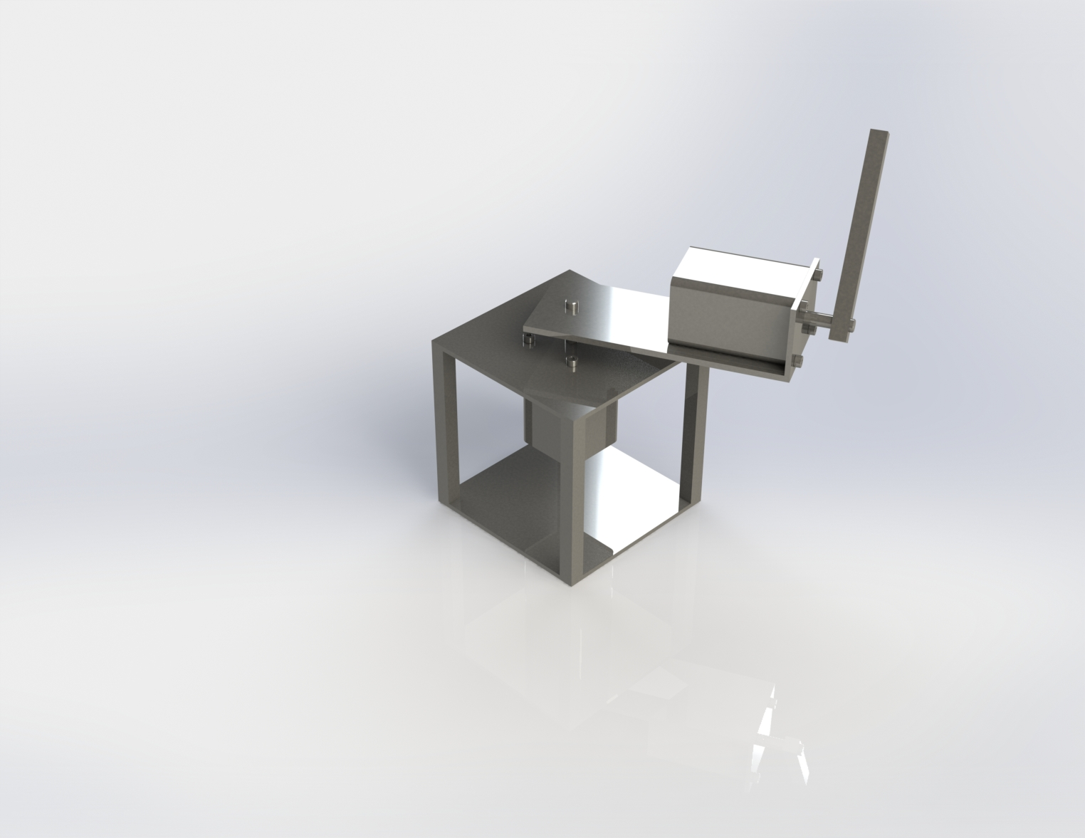
Furuta Pendulum
Efrain Cobian, Aaron Dizon, Michael Korhummel

Slide 2
Introduction
For this project we will be designing a mathematical model used to design a self balancing Furuta Pendulum. For this design SolidWorks, MATLAB and Simulink will be used for the software programs.
For the project, an inverted pendulum will be developed and control the pendulum arm in its upright position by apply a torque to respond to a disturbance through a motor in the rotary arm. The repository will contain all of the deliverables as mentioned above.

Slide 3
Requirements
- Present project and build a webpage that contains all deliverables.
- Mathematical model of the system.
- Control system should be provided via simulink, stateflow, or other highlievel programming language.
- System will have a simulation with the control system and mathematical model by connecting Coppelia sim to MATLAB, simulink, or whatever programming landscape is used.

Slide 4
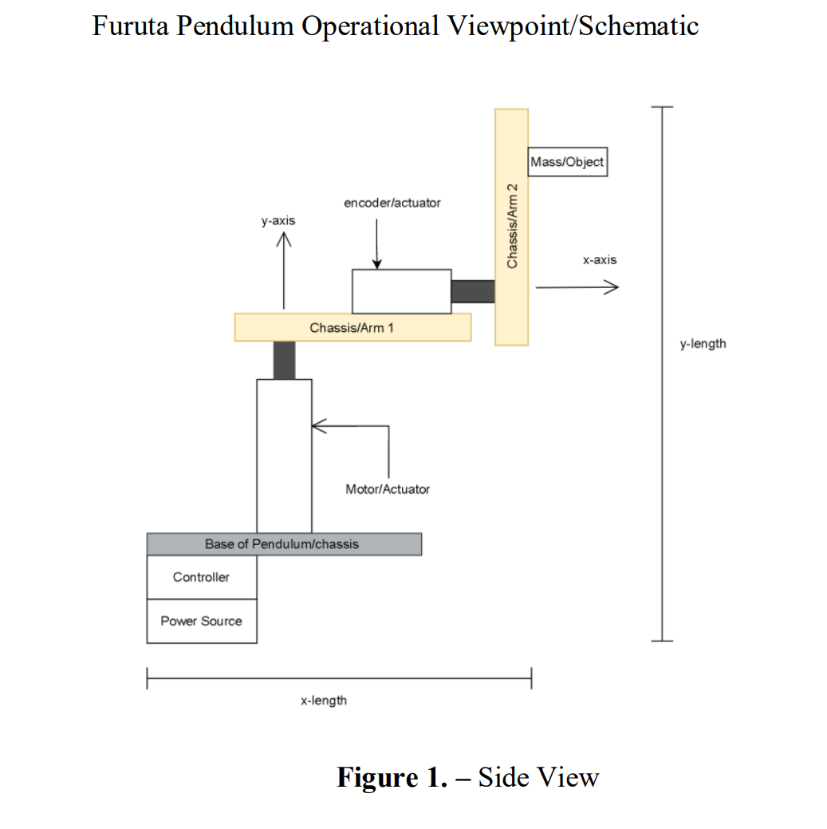
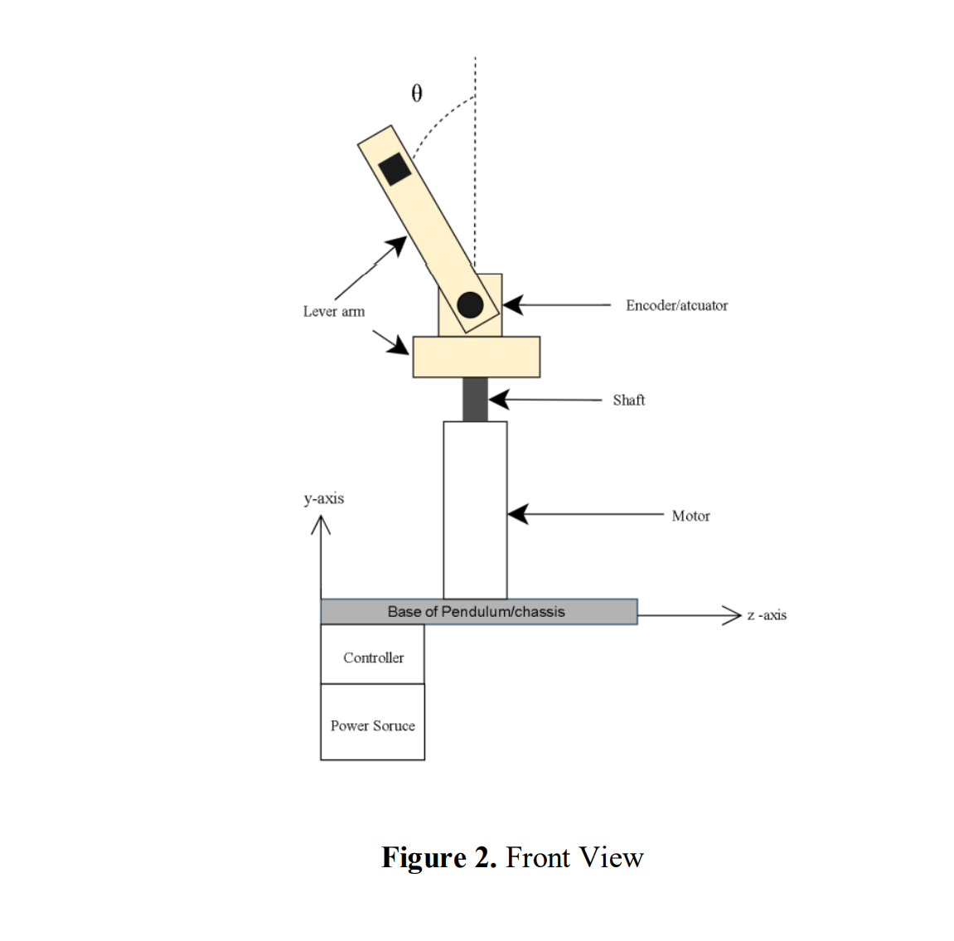
Operational Viewpoint

Slide 5
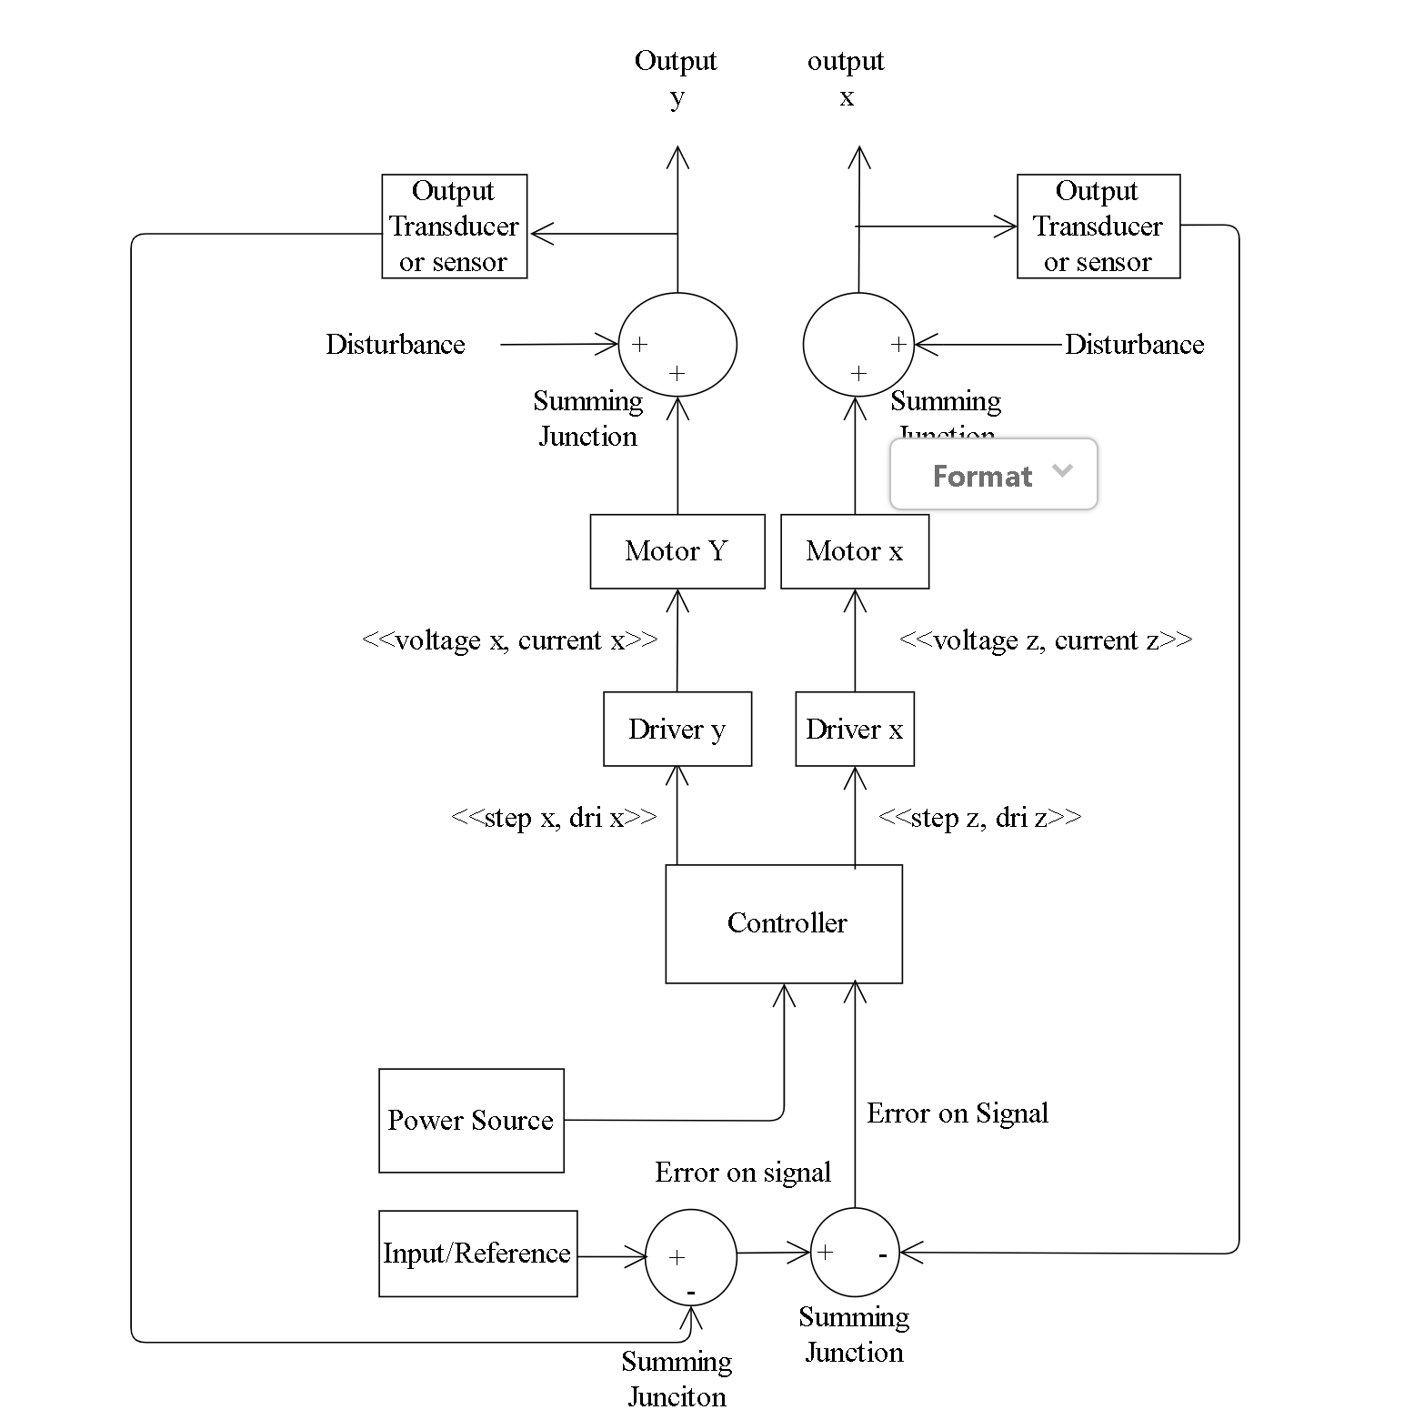
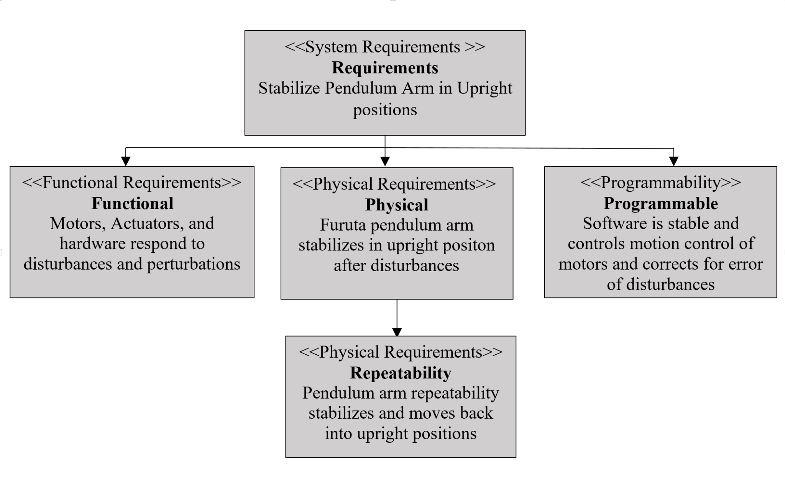
Logical / Functional Viewpoint

Slide 6
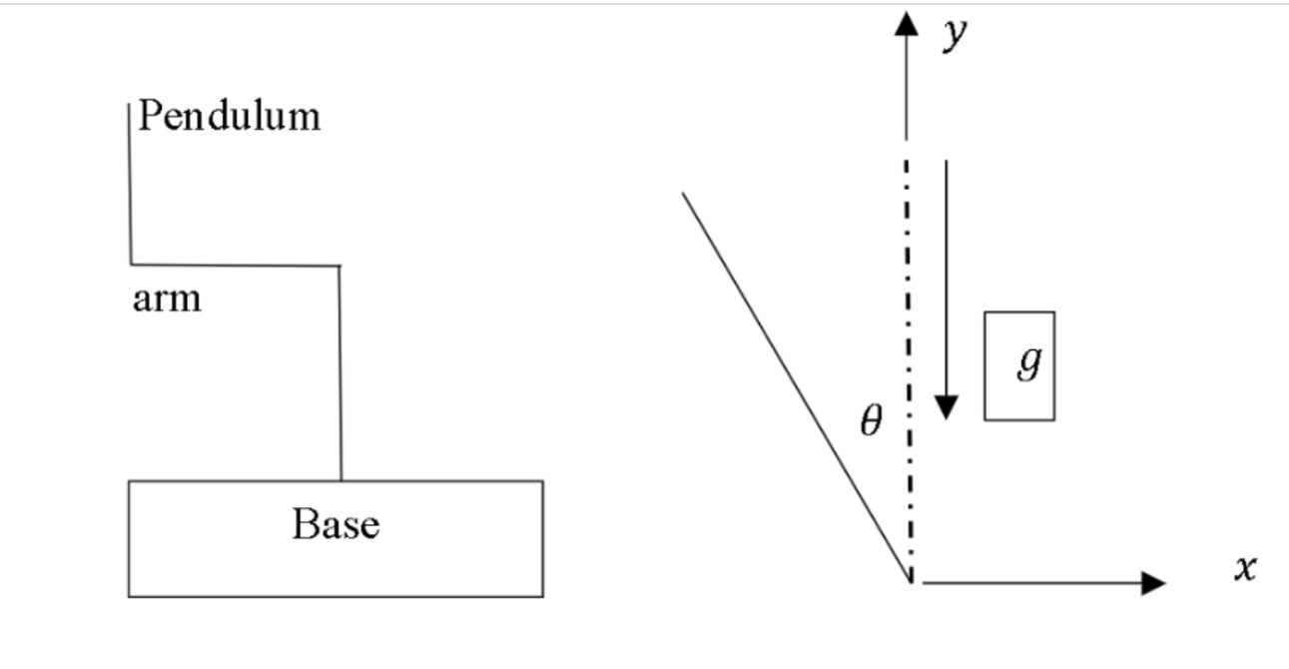
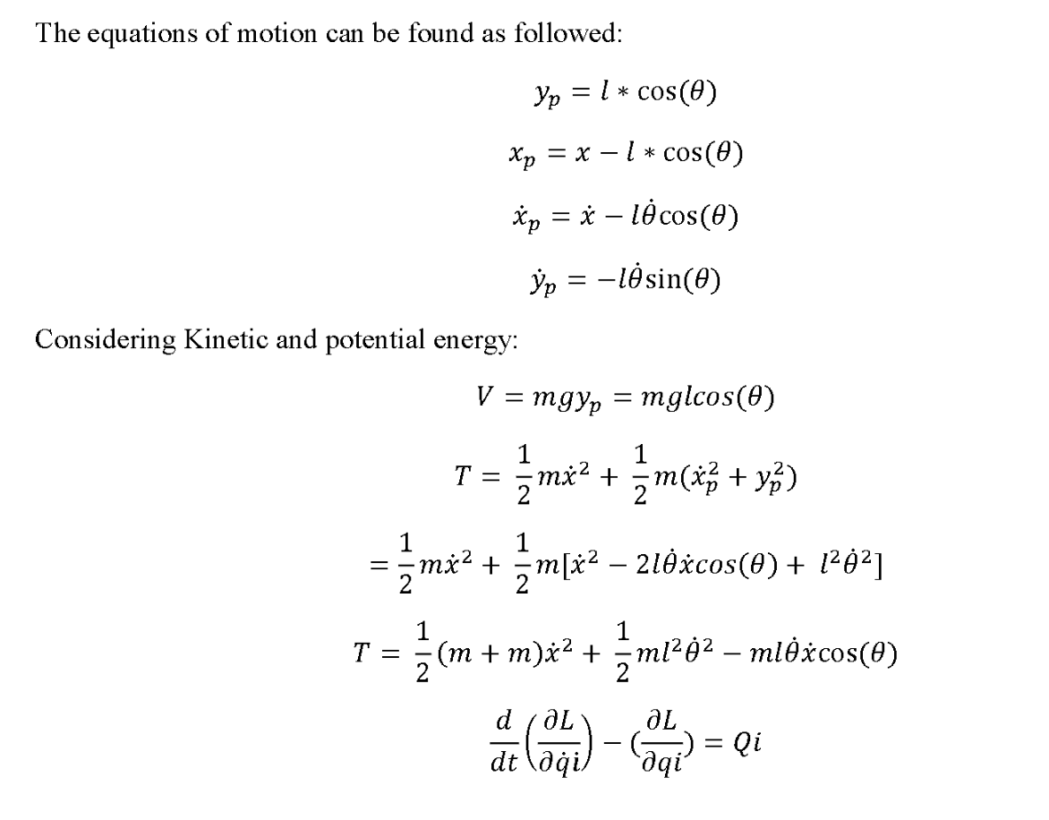
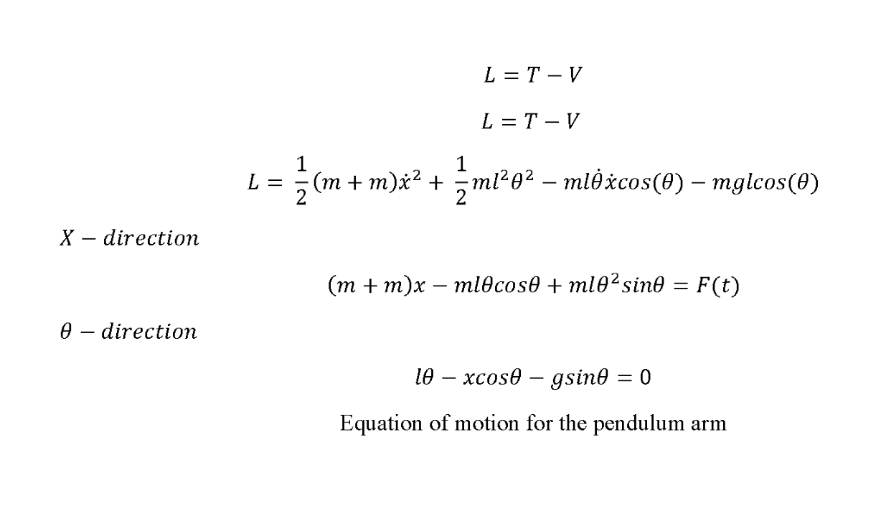
Mathematical model

Slide 7
MatLab Simulink

Slide 8

Solidworks Renderings

